Slide 1

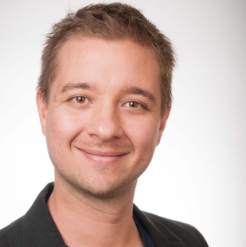
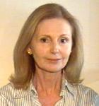
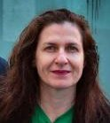

Creative Commons Australia
Carpeted commons by Glutnix, http://www.flickr.com/photos/glutnix/2079709803/in/pool-ccswagcontest07 available under a Creative Commons Attribution 2.0 licence, http://creativecommons.org/licenses/by/2.0/deed.en
Project lead:
Nicolas Suzor n.suzor@qut.edu.au
Project manager:
Nerida Quatermass n.quatermass@qut.edu.au
Potential new affiliates:
Education lead: Delia Browne, National Copyright Unit http://www.smartcopying.edu.au
Government lead: Baden Appleyard, AusGOAL www.ausgoal.gov.au/

Slide 2
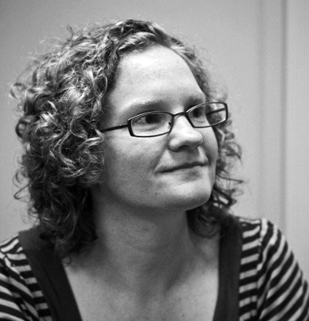

Creative Commons Australia
Carpeted commons by Glutnix, http://www.flickr.com/photos/glutnix/2079709803/in/pool-ccswagcontest07 available under a Creative Commons Attribution 2.0 licence, http://creativecommons.org/licenses/by/2.0/deed.en
And wonderful volunteers:
Jess Coates!
Elliott Bledsoe!
QUT students and external volunteers: Nat Cameron, Shannon Miller, Ray Dowling, Rex Cho, Jessica Price, Jessica Pietsch
Roadmap 2014:
New series of fact sheets ready soon
Copyright policy advocacy:
Fair use in Australia
Submission opposing graduated response scheme (with Office for Transformative Works)
Supporting schools, universities, governments, GLAM
Re-engaging creators!

